Slide 1

14.2 Limits and Continuity in Higher Dimensions
This section treats limits and continuity for multivariable functions. These ideas are analogous to limits and continuity for single-variable functions, but including more independent
variables leads to additional complexity and important differences requiring some new ideas.

Slide 2


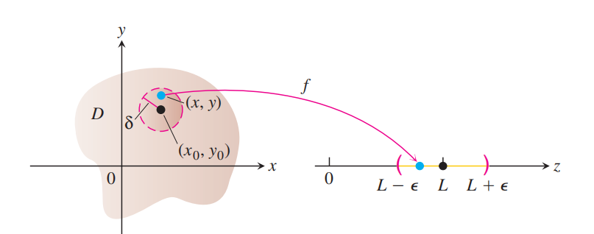

Slide 3
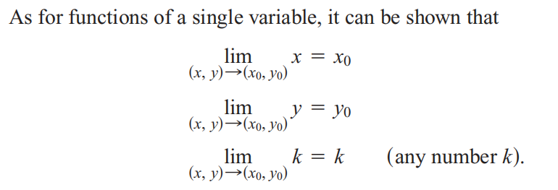

Slide 4
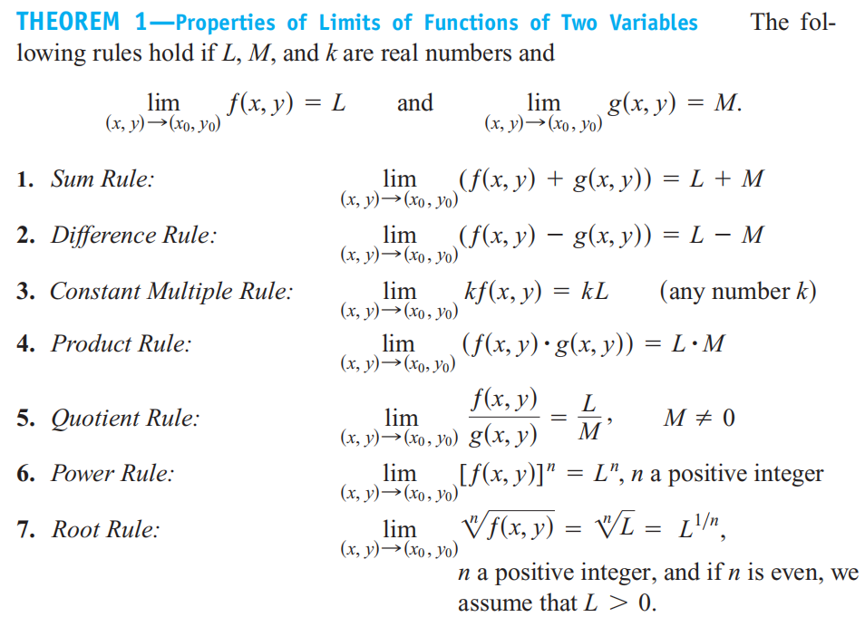

Slide 5



Slide 6

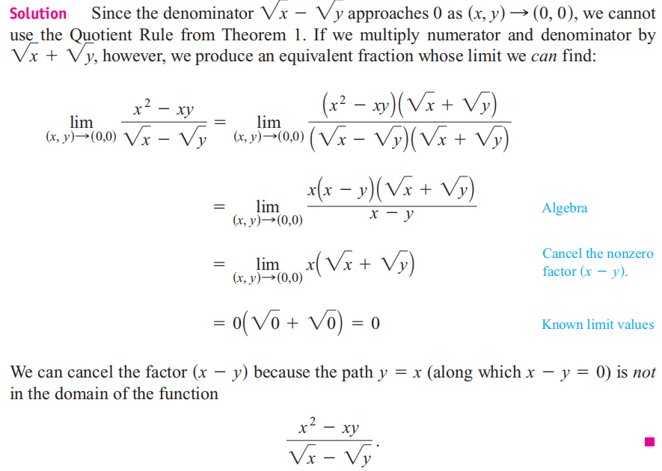

Slide 7

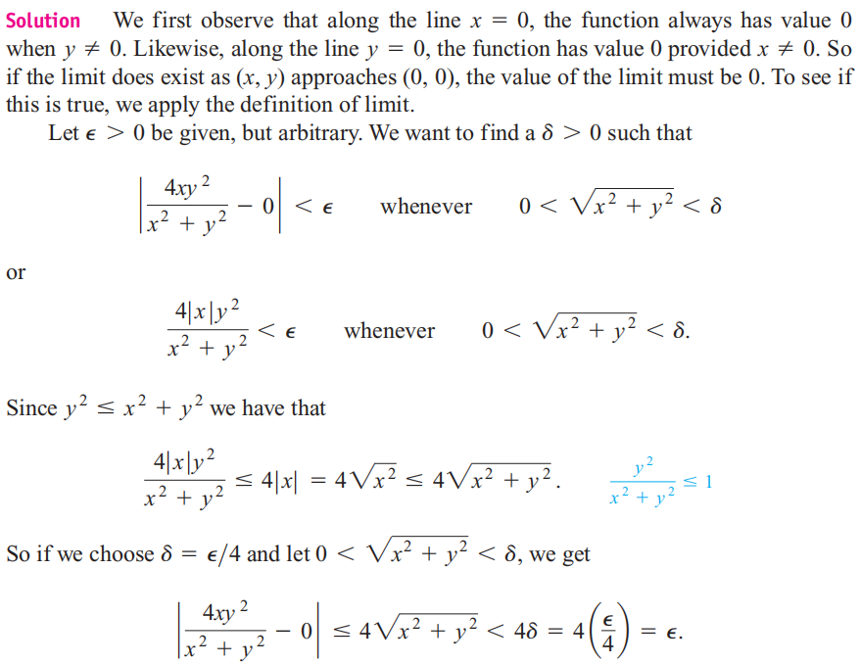

Slide 8


Slide 9
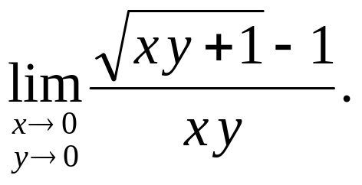
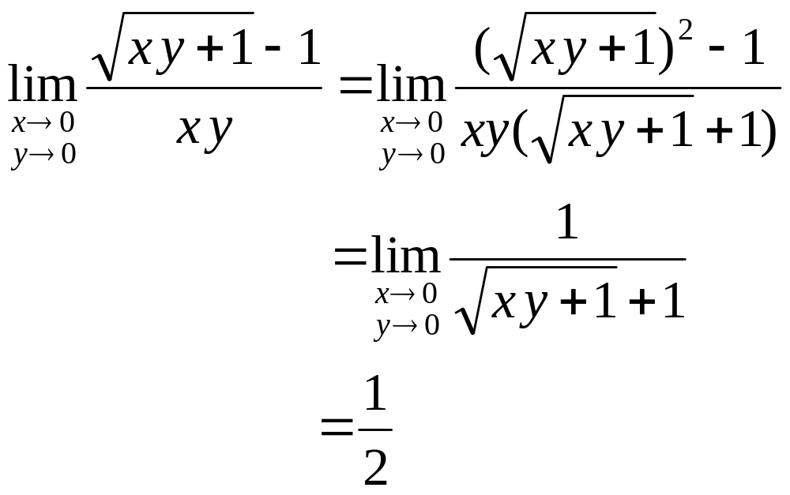

Example: Find the limit
Solution:

Slide 10
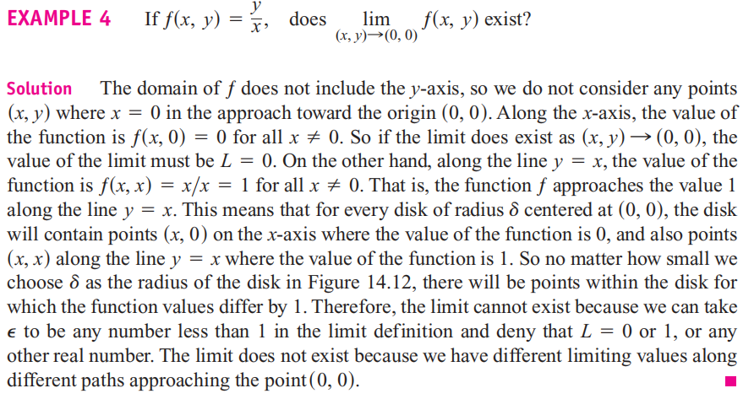

Slide 11
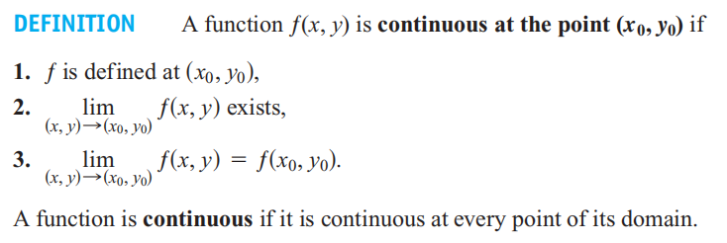
Continuity

Slide 12

Result: All elmentary multivariable functions are continuous on the conected region contained in their domains.

Slide 13
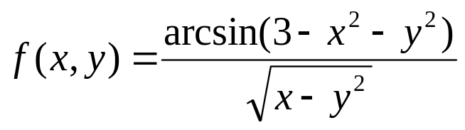
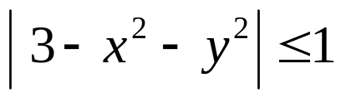

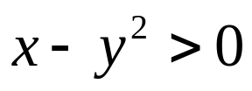





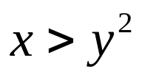
Examle: Find the set of points where the function
is continuous.
Solution:

Slide 14
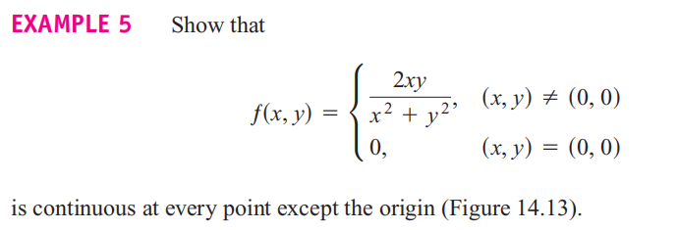

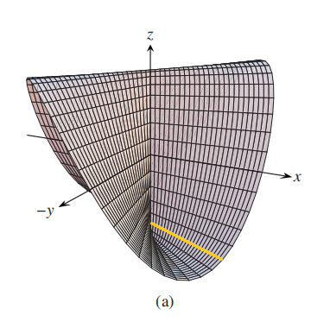

Slide 15
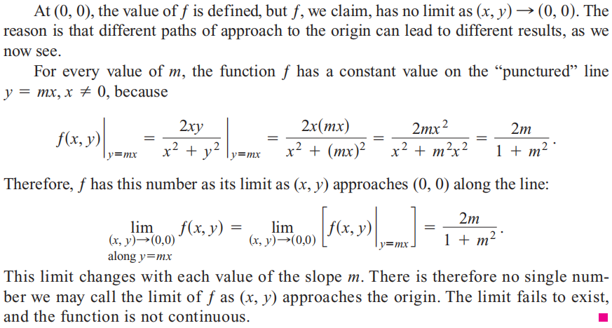

Slide 16



Slide 17
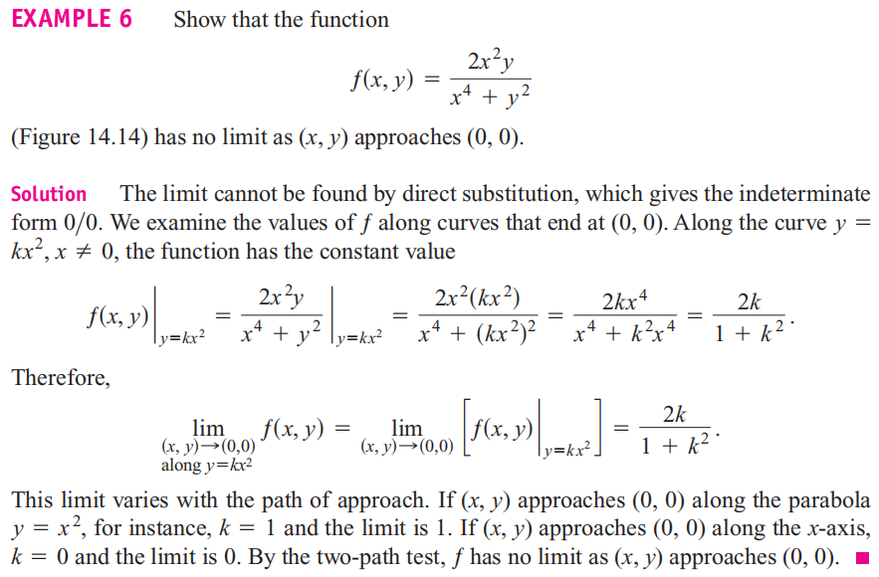

Slide 18
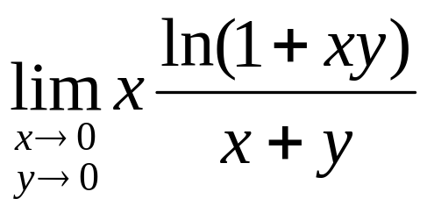

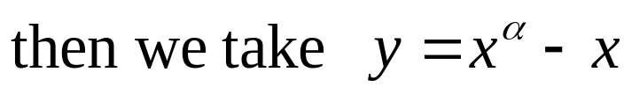
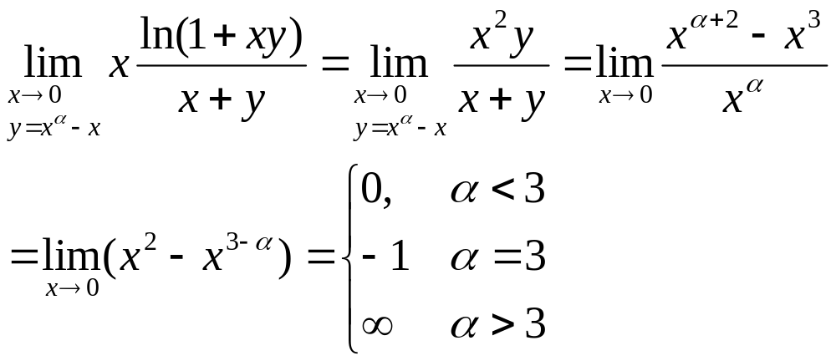
Example： Determine if exits
Solution：
Therefore, the limit doesn't exist.

Slide 19



Slide 20
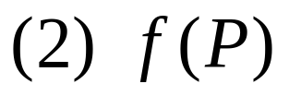
Extreme Values of Continuous Functions on Closed, Bounded Sets
Theorem：If f (P) is continuous on a closed and bounded set D , then
can achieve its absolute maximum M and minimum m on D ;
(3) For any

Slide 21
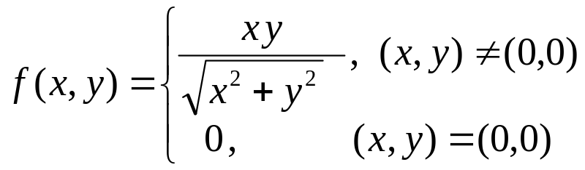
Example： Show that
is continuous on the entire plane.

Slide 22


Slide 23
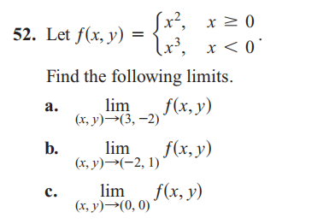

Slide 24


